Slide 1
MNK game
Wadood Alam, Matthew Pacey, Joe Nguyen

Slide 2
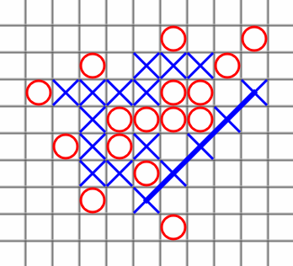
Introduction the game
Generalization of tic tac toe game
M x N board
the winner is the player who first gets K stones of their own color in a row, horizontally, vertically, or diagonally
Example of a completed 11,10,5-game

Slide 3
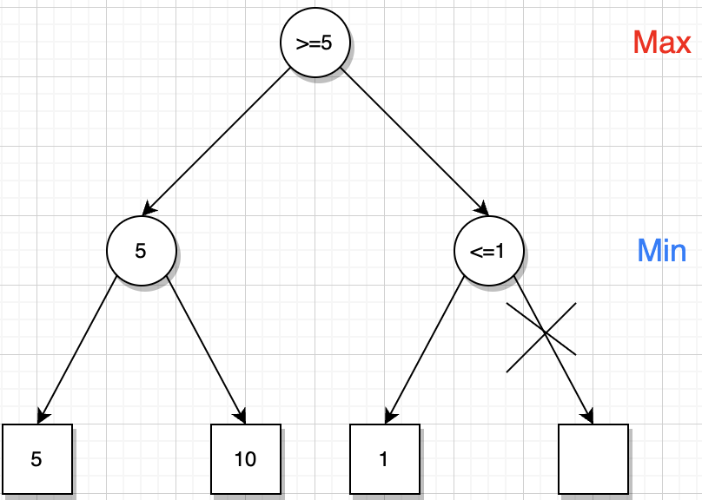

Search Algorithm: Alpha Beta Pruning
Minimax: Min player tries to minimize the utility of max player i.e player 2 prevents player 1 from winning
Alpha-Beta: Optimized version of minimax
  Prune when current value <= alpha if MIN
  Prune when current value >= beta if MAX
Heuristic Ordering: Select the empty cell with the most occupied neighbors

Slide 4
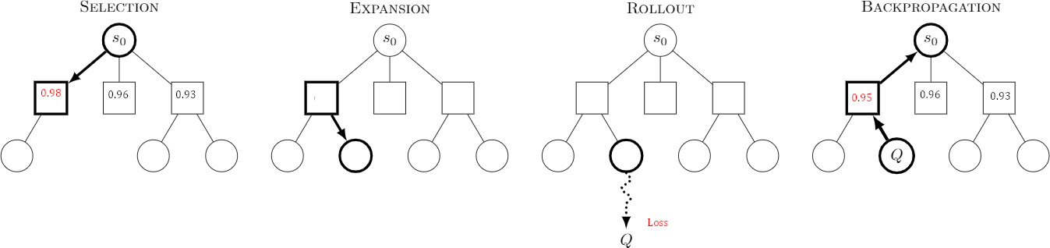
Search algorithm: Monte Carlo Tree Search
Node Selection: value = X_{i} + C * √(p_{i}/ n_{i}) where:
Exploitation: X_{i} = Node wins / games
Exploration: C = constant (1.1); p_{i} = log(parent node’s games); n_{i} = (node games);
Node Expansion Heuristic: Select the empty cell with the most occupied neighbors

Slide 5
Experiments
6 different boards: 3x3, 3x4, 4x4, 4x5, 5x5, 6x5
  3 square; 3 rectangular
Minimax + Alpha-beta with heuristic ordering
  Depth Limit = 5
Varying K from 3 to M where M is the num of rows
Number of iterations in MCTS = 500
𝞪-β vs MCTS
MCTS vs 𝞪-β
MCTS vs MCTS with varying MCTS Iterations per player

Slide 6
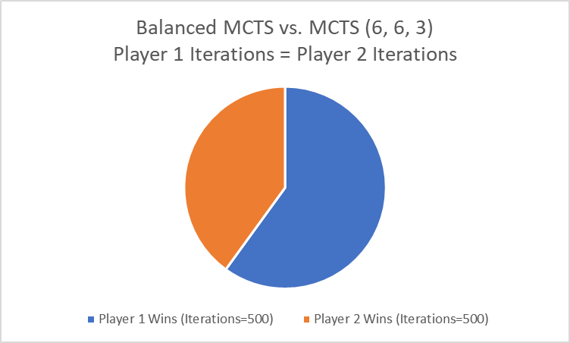
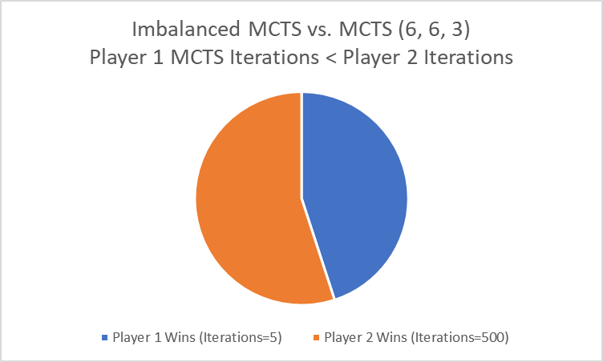
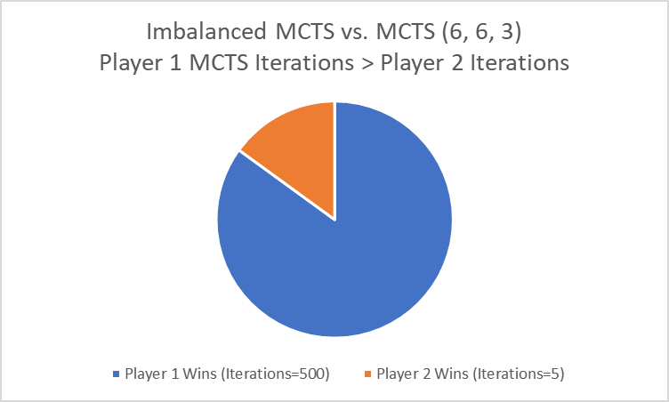
Results: MCTS Iteration Variance
Player 1(first to move) has a slight advantage
Increasing MCTS Iterations allows Player 2
to overcome advantage
P1 Wins | P2 Wins | P1 Iterations | P2 Iterations
60 | 40 | 500 | 500
45 | 55 | 5 | 500
85 | 15 | 500 | 5

Slide 7
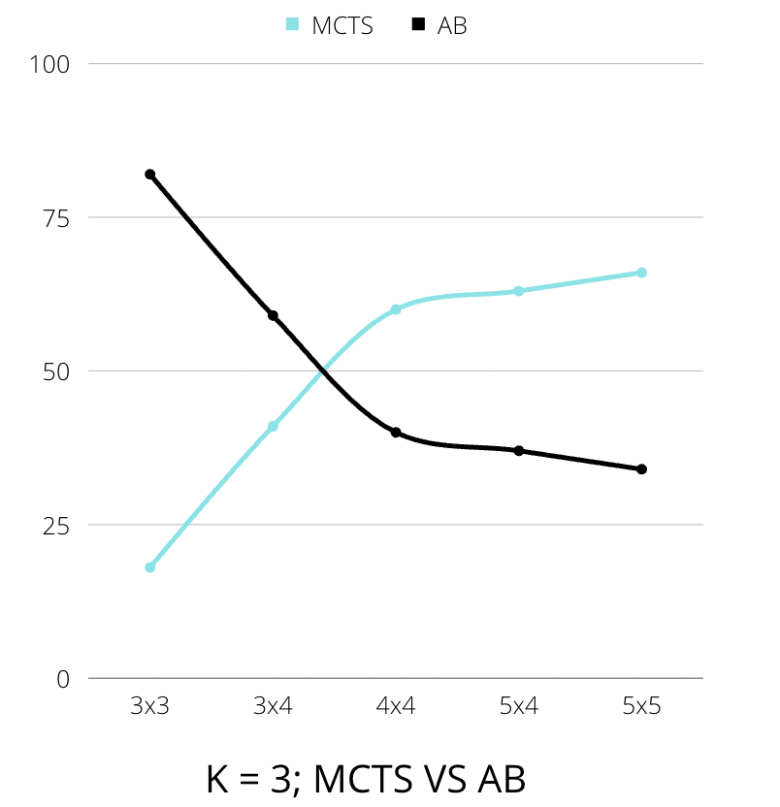
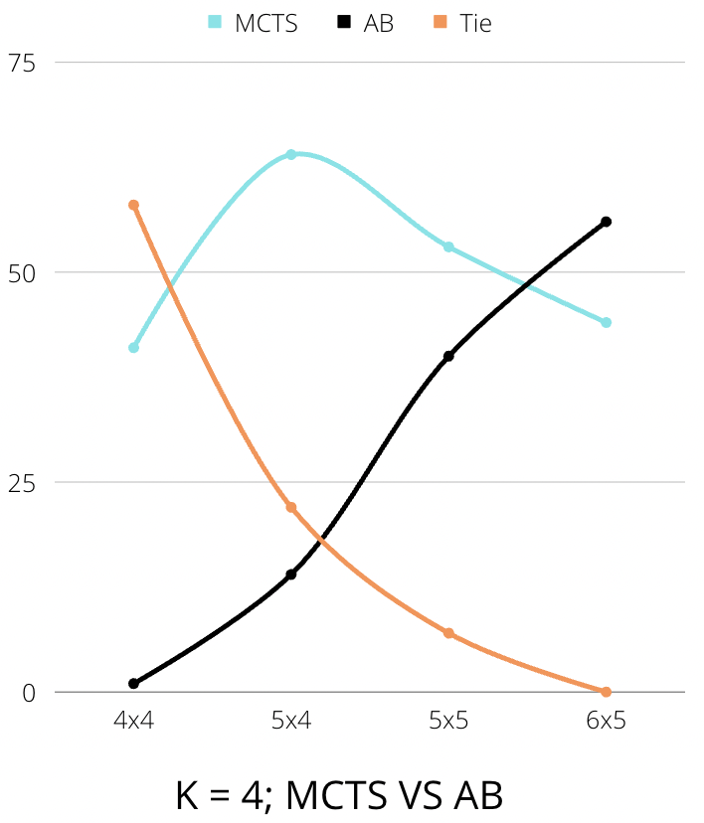
MCTS(1) VS AB(2)
Win %
Win %

Slide 8
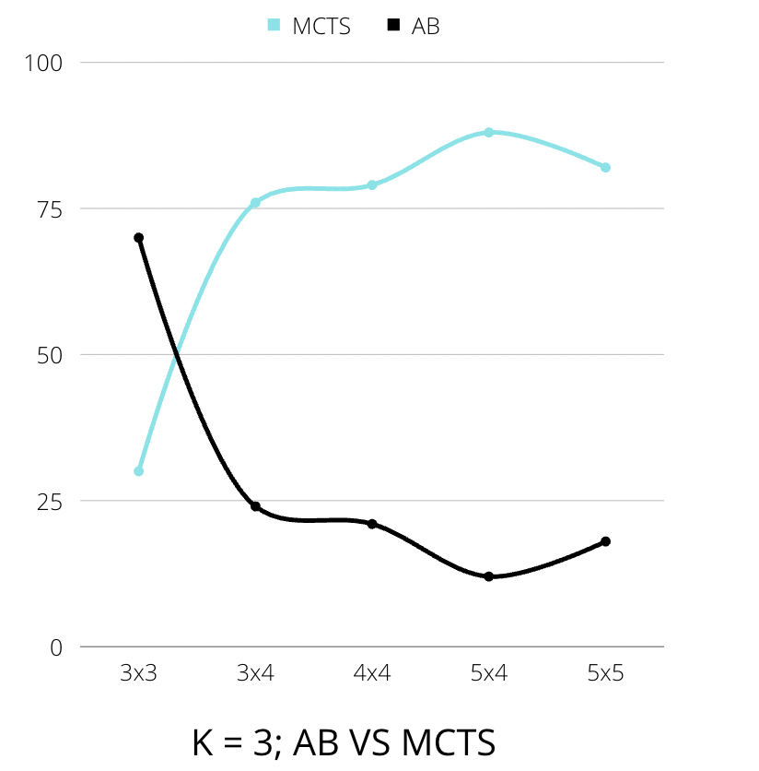
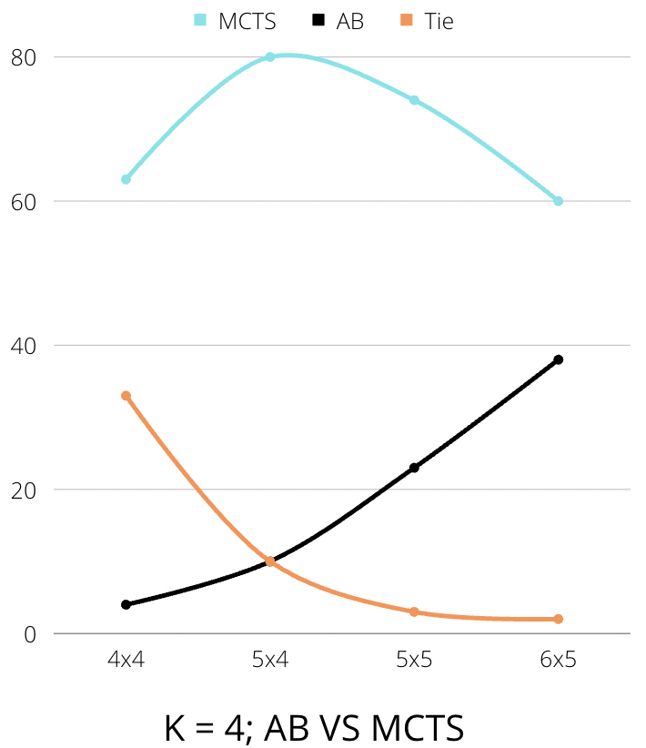
AB(1) VS MCTS(2)
Win %
Win %

Slide 9
Discussion
Player 1 has an advantage
High K values led to more ties
Keeping a consistent depth limit of 5, our data makes sense because as the board size increases more nodes need to be expanded. By a lower depth limit it is expected to have more ties. The tradeoff is that it takes less compute time.
Increasing the number of MCTS Iterations increases score. The optimal value seemed to be 500 iterations (number of playouts to simulate for each move decision), past that not many wins were gained at the expense of longer compute time.
MCTS is better than Alpha-Beta when the problem is simple unless K = 4, where Alpha-Beta is unable to model a large tree search
With heuristic and without heuristic there is a clear difference between the number of nodes expanded (hence more time taken). Thus we decided to keep a consistent, lower depth limit of 5

Slide 10
Thank you!
Questions & Concerns

Slide 11
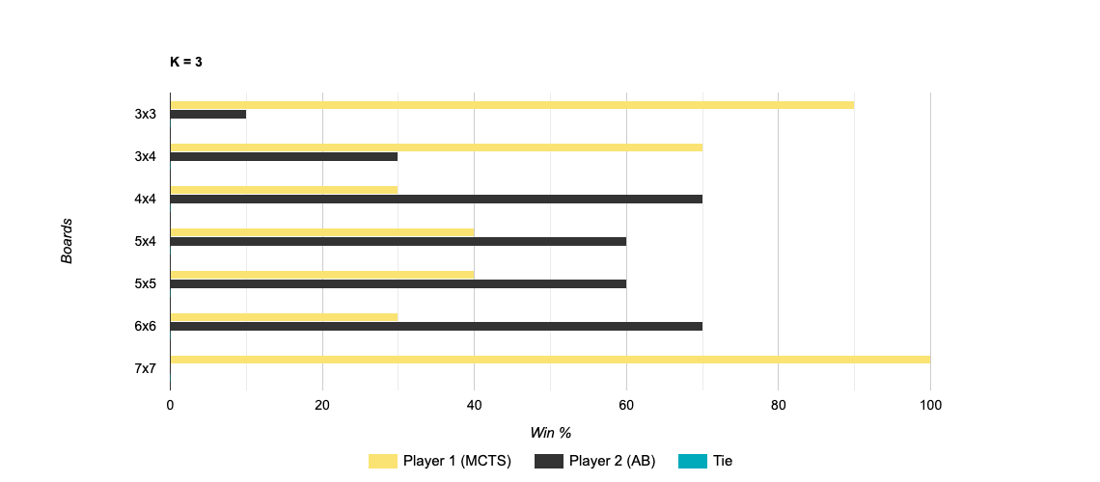
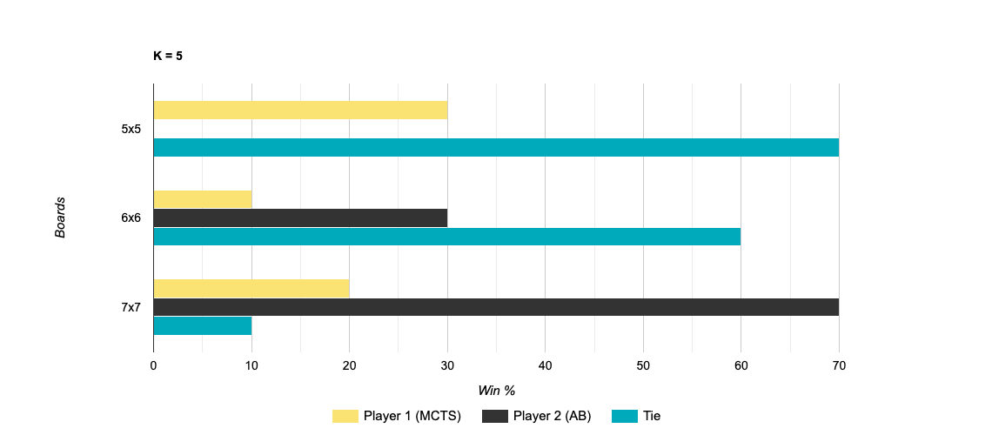
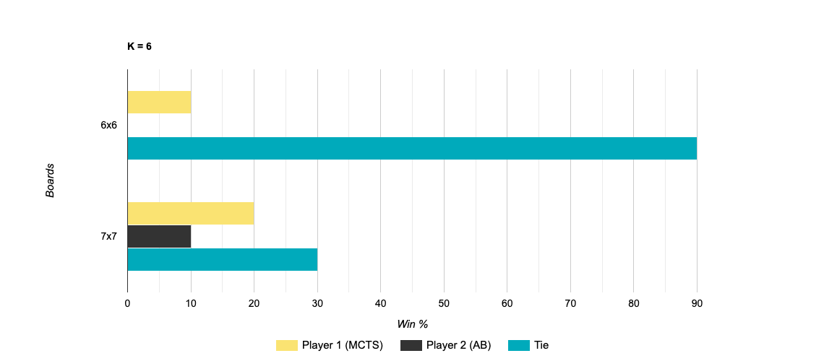
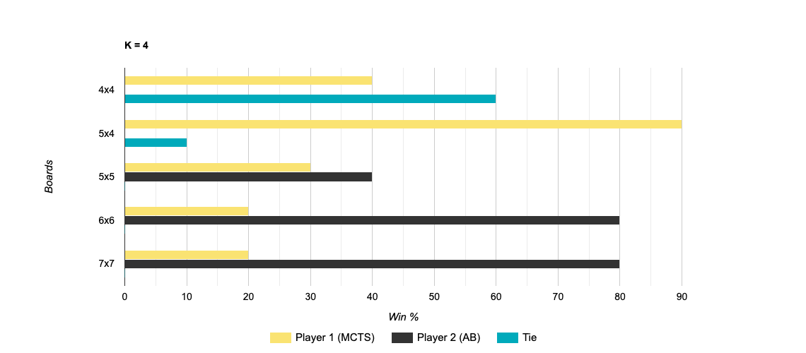
MCTS VS AB
Notes:
MCTS wins k = 3
Skewed k = 4
Skewed k = 5
More ties with MCTS better k = 6

Slide 12
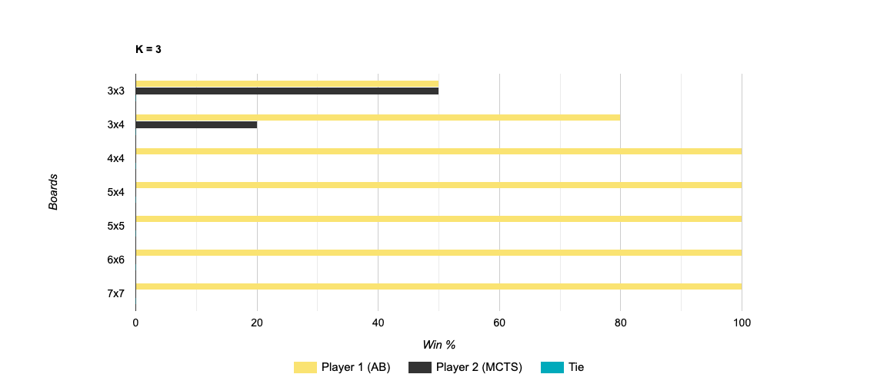
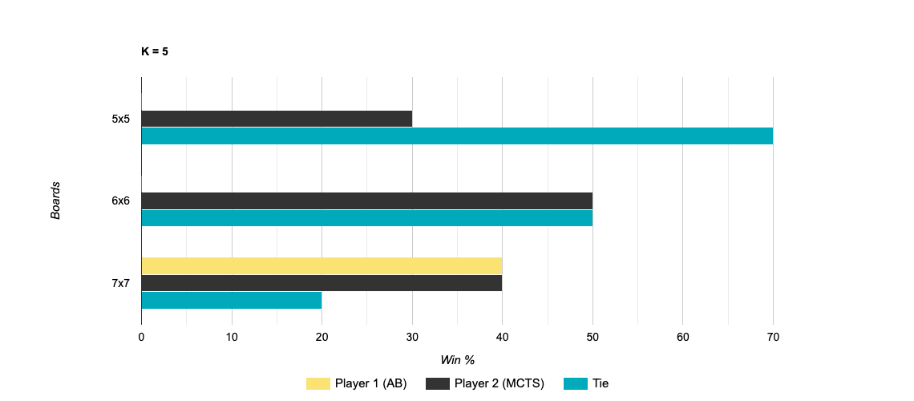
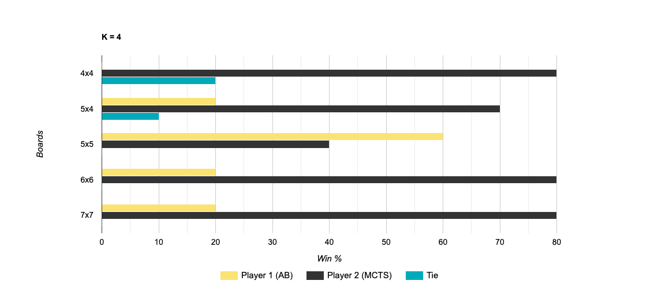
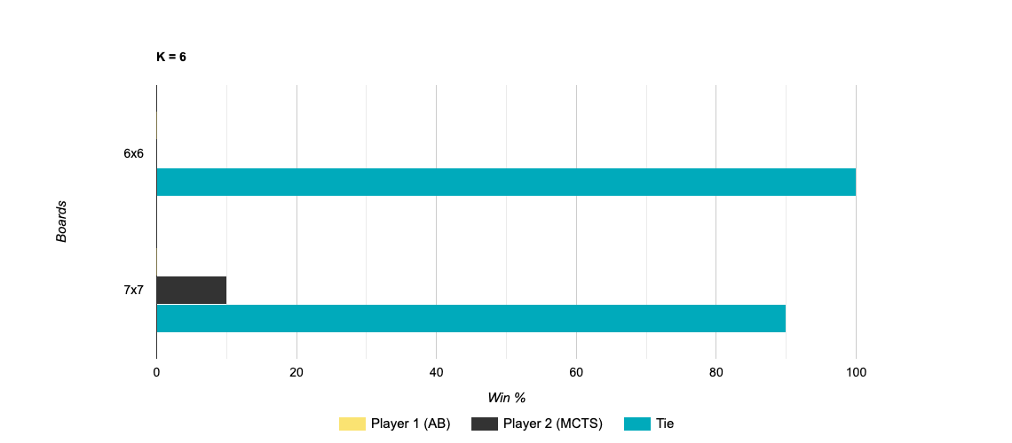
AB VS MCTS
Notes:
AB Wins k =3
MCTS wins k = 4
Draw/MCTS wins mostly k = 5
Draw k =6

Slide 13
Minimax + Alpha-beta with / without heuristic ordering
Max_depth = inf
Size of the game | Number of nodes expanded |  | Percentages compared to without
 | Without heuristic ordering | With heuristic ordering
3 x 3 k = 2 | 165 | 26 | 15.75%
3 x 3, k = 3 | 18297 | 536 | 2.93%
4 x 4, k = 2 | 813 | 47 | 5.78%
4 x 4, k = 3 | 1024394 | 4242 | 0.41%!!
4 x 4, k = 4 | Too long to run | Too long to run

